Slide 1
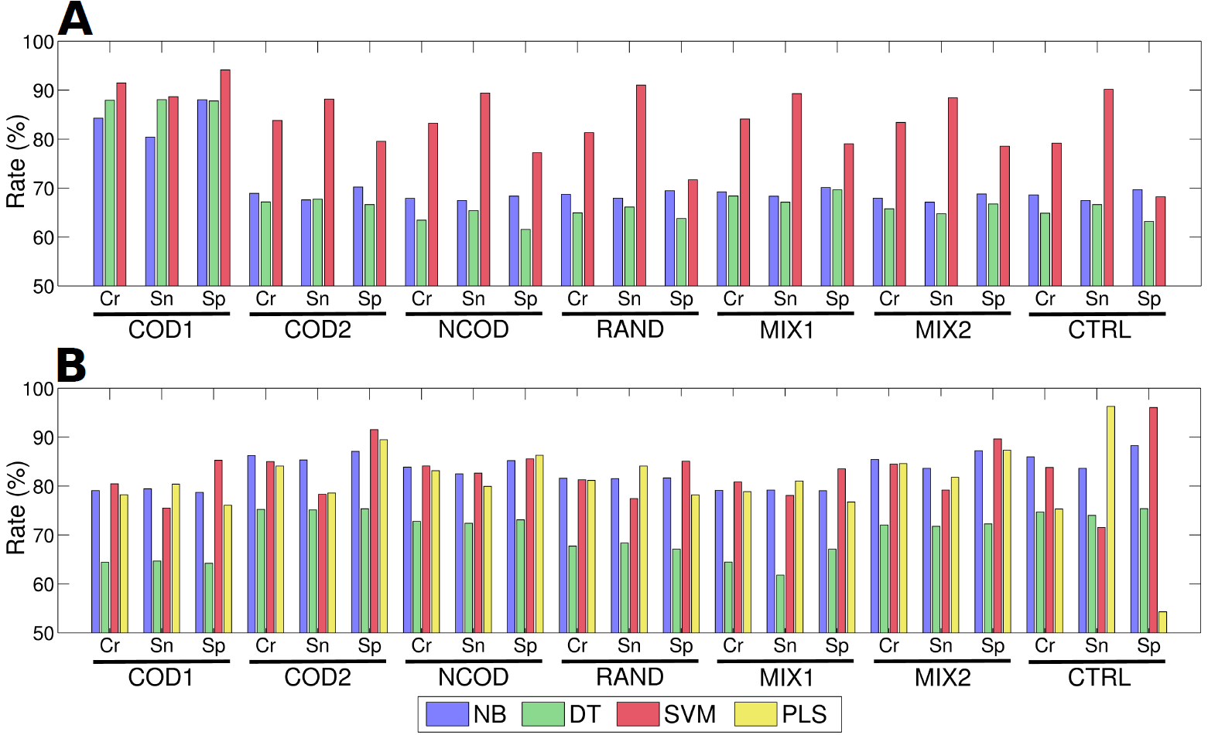
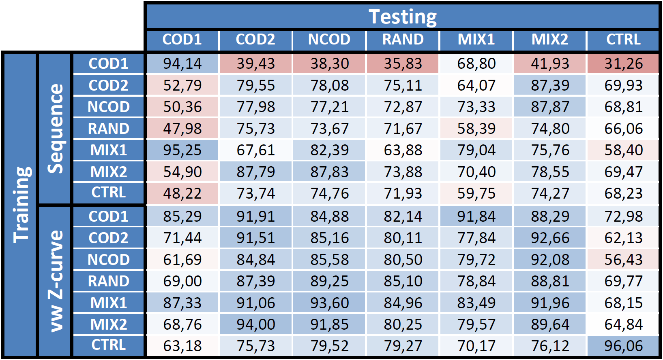
Issues on Sampling Negative Examples for Predicting Prokaryotic Promoters
Eduardo G. Gusmão* and Marcilio C. P. de Souto⁺
* IZKF Aachen Comp. Bio. Research Group/RWTH Aachen Univ. , Germany ⁺ LIFO/Univ. Orléans, France
Issues on sampling negative examples. In many research fields, experimental identification of negative examples can be laborious, expensive or unfeasible. Particularly in bioinformatics, this problem appears in several areas such as prediction of mRNAs that are target of miRNAs, regulatory networks, protein-protein interactions, non-coding RNA finding, among others. In the context of prokaryotic promoter prediction, various definitions of negative examples have been made. Here, we study the impact of different negative dataset definitions in the context of prokaryotic promoter prediction.
Experimental Design. First, we obtained an experimentally verified positive dataset for E. coli in RegulonDB. Then, we defined/created common representations of negative datasets in the literature. Finally, we made several experiments using a representative set of classification techniques in two different scenarios:
Sequence: DNA sequences (categorical attributes).
vw Z-curve: Numerical features extracted from the DNA sequences using the variable-window (vw) Z-curve method.
Datasets
Dataset | MEME Top-Enriched Motif | Nucleotide Freq. (%) |  |  |  | Description
 |  | A | C | G | T
POS |  | 29.04 | 20.48 | 20.00 | 30.48 | Known (experimentally verified) promoters from RegulonDB
COD1 |  | 26.62 | 22.29 | 24.88 | 26.21 | Start of E. coli’s coding regions
COD2 |  | 24.19 | 24.58 | 27.21 | 24.02 | Random part within E. coli’s coding regions
NCOD |  | 23.94 | 25.01 | 26.78 | 24.27 | E. coli’s non coding regions (convergent intergenic spacers)
RAND |  | 24.46 | 25.79 | 25.34 | 24.41 | Random non-promoter regions within E. coli’s genome
MIX1 |  | 25.47 | 23.35 | 25.83 | 25.35 | 50% COD1 + 50% NCOD
MIX2 |  | 24.02 | 24.69 | 27.14 | 24.15 | 50% COD2 + 50% NCOD
CTRL |  | 24.62 | 25.42 | 25.37 | 24.59 | Completely random sequences given E. coli’s nucleotide frequencies
First Case Study
Second Case Study
Performance assessment with the usual 10-fold cross-validation procedure. Results are shown for sensitivity (Sn), specificity (Sp) and accuracy (Cr) of all classifiers.
Performance assessment when training/testing with different negative datasets. Results are shown for the specificity of the SVM classifier.
30
65
100

